Slide 1
Kabootar
Project Title :- Kabootar
Your Name :- Aviral , Dhruv, Naresh ,Tushar
University Name :- GLA University
Department Name :- Computer Science and Engineering
Date :- 29/11/2023

Slide 2
Introduction
The project aims to enhance the efficiency of a parcel delivery company through the implementation of a streamlined and technology-driven logistics system.
Addressing the challenges of timely and accurate parcel deliveries, the project seeks to optimize routes, minimize delays, and improve overall customer satisfaction
The audience can expect a presentation of innovative solutions, including real-time tracking, automated scheduling, and data analytics, designed to elevate the performance and service quality of the parcel delivery company.

Slide 3
Objectives
The objectives of our mini project include implementing an efficient parcel delivery system with real-time tracking, optimizing delivery routes, and enhancing overall logistics management for a seamless customer experience.
The aim is to streamline and modernize the parcel delivery process, reducing delivery times, minimizing costs, and increasing customer satisfaction through the integration of advanced technologies and optimized operational strategies.

Slide 4
Problem Statement
The problem addressed is the inefficiency in traditional parcel delivery systems, marked by delayed deliveries, suboptimal route planning, and limited visibility into the delivery process.
The inefficiencies in parcel delivery lead to customer dissatisfaction, operational costs, and environmental impacts. Addressing this problem is crucial to enhance customer experience, optimize logistics, and contribute to a more sustainable and effective delivery ecosystem.

Slide 5
Literature Review
Previous work in parcel delivery optimization includes route planning algorithms, real-time tracking systems, and logistics management solutions, aiming to enhance operational efficiency and customer satisfaction in the logistics industry.
While existing solutions focus on specific aspects, our project bridges gaps by providing a holistic approach, integrating advanced technologies for route optimization, real-time tracking, and automated scheduling to create a comprehensive and efficient parcel delivery system.

Slide 6
Methodology
Adopted a data-driven methodology, involving problem definition, data collection, algorithm selection,model training, iterative improvement, and final deployment.
Languages: HTML, CSS, JavaScript for web development.
API Integration: Utilized API calls for data retrieval or interaction.

Slide 7
System Architecture
HTML, CSS, JavaScript: Used for structuring content, styling, and providing interactivity on the client side.
Browser: Renders the HTML, applies styles with CSS, and executes JavaScript for dynamic behavior.
The client (web browser) sends HTTP requests to the server for different resources (HTML, CSS, images).
The server processes these requests and responds with the corresponding files.
The client renders the received HTML, applies styles, and executes scripts for a dynamic user interface.

Slide 8
Implementation
Requirements Gathering
Design and Architecture
Development of Tracking System
User Interface Development
Code snippets or screenshots if applicable

Slide 9
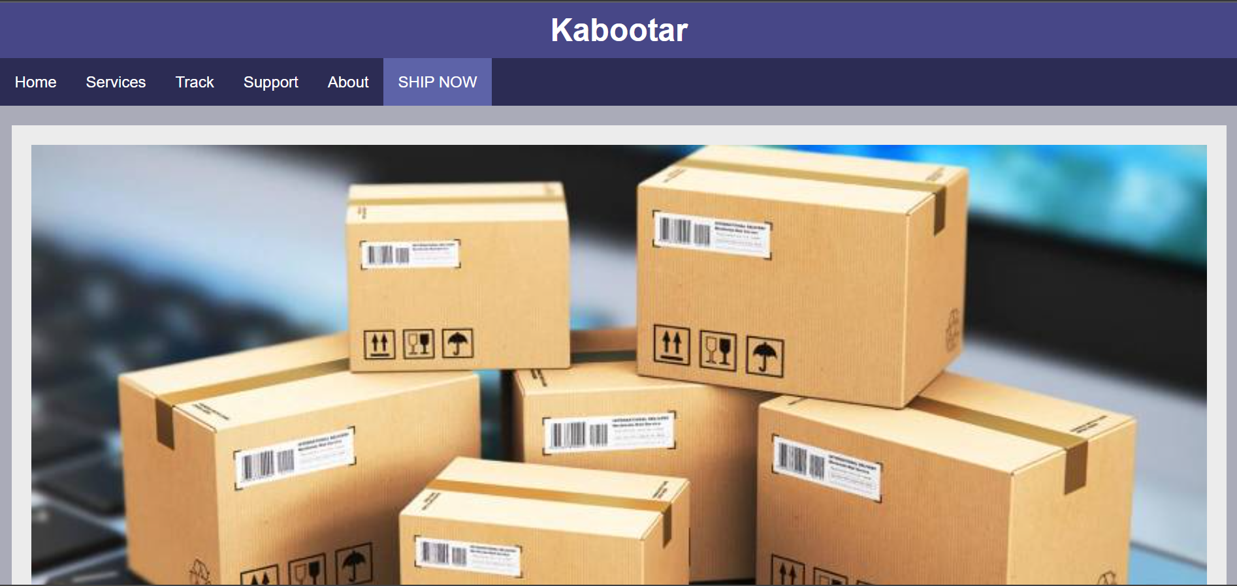
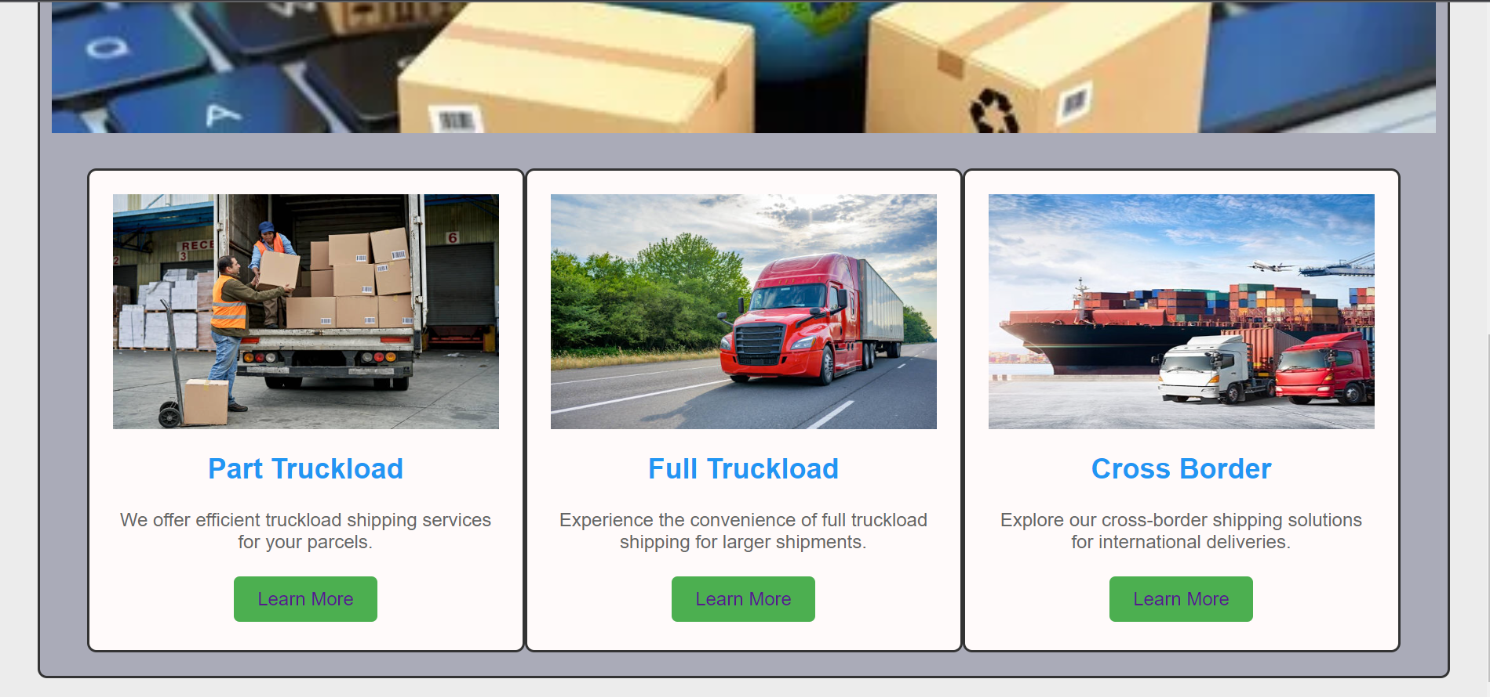
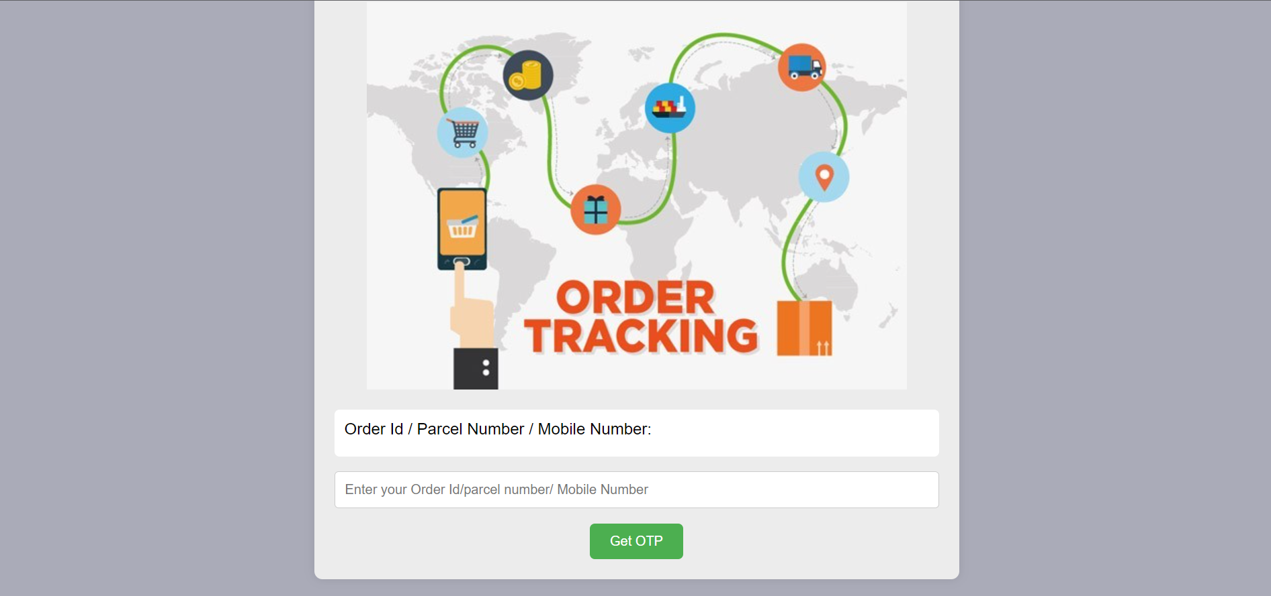
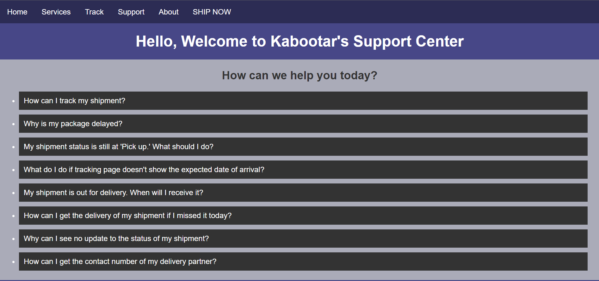
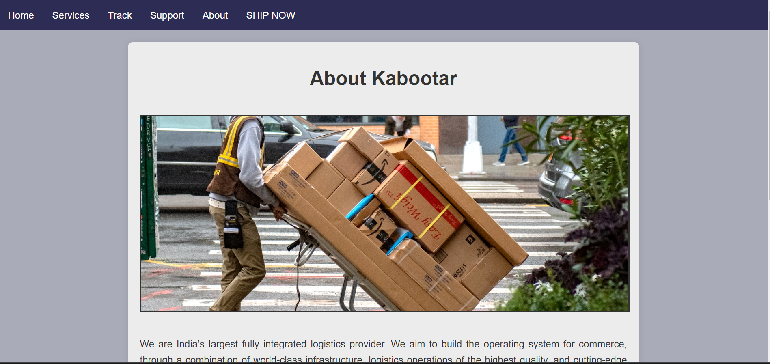
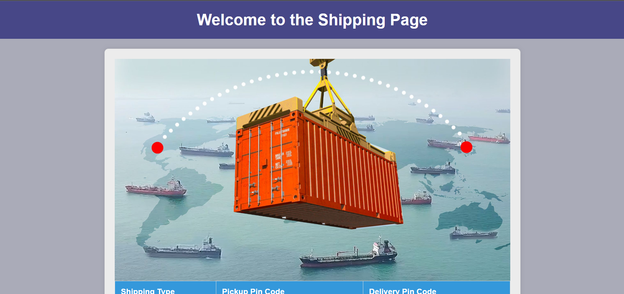
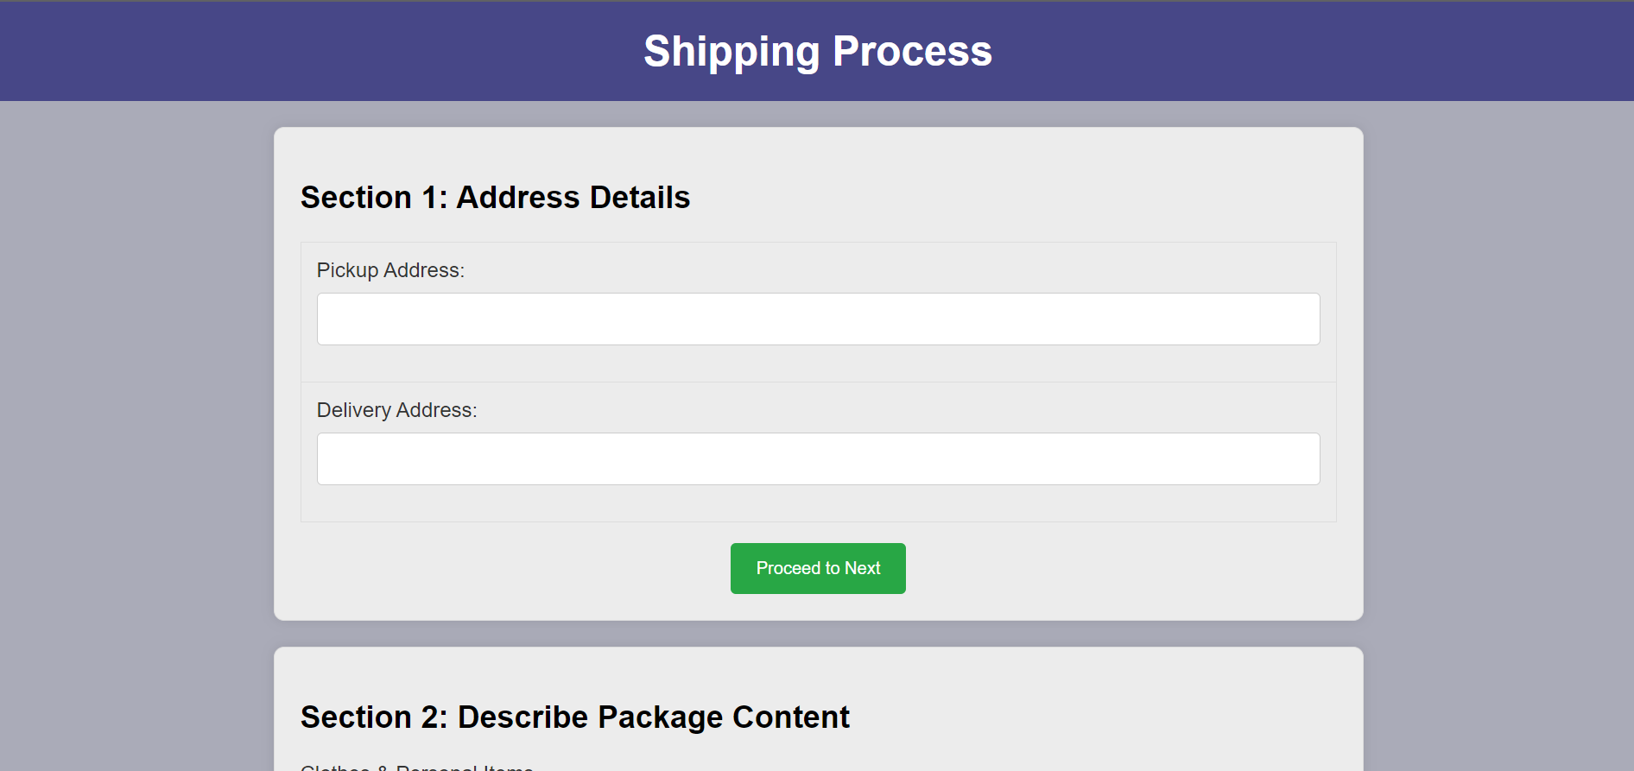
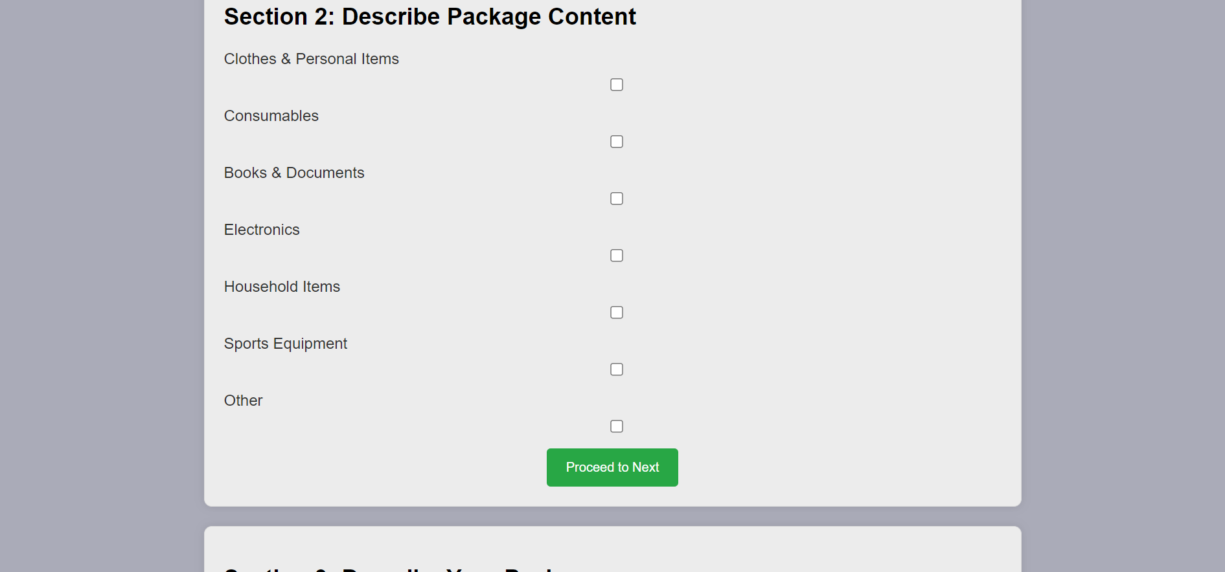
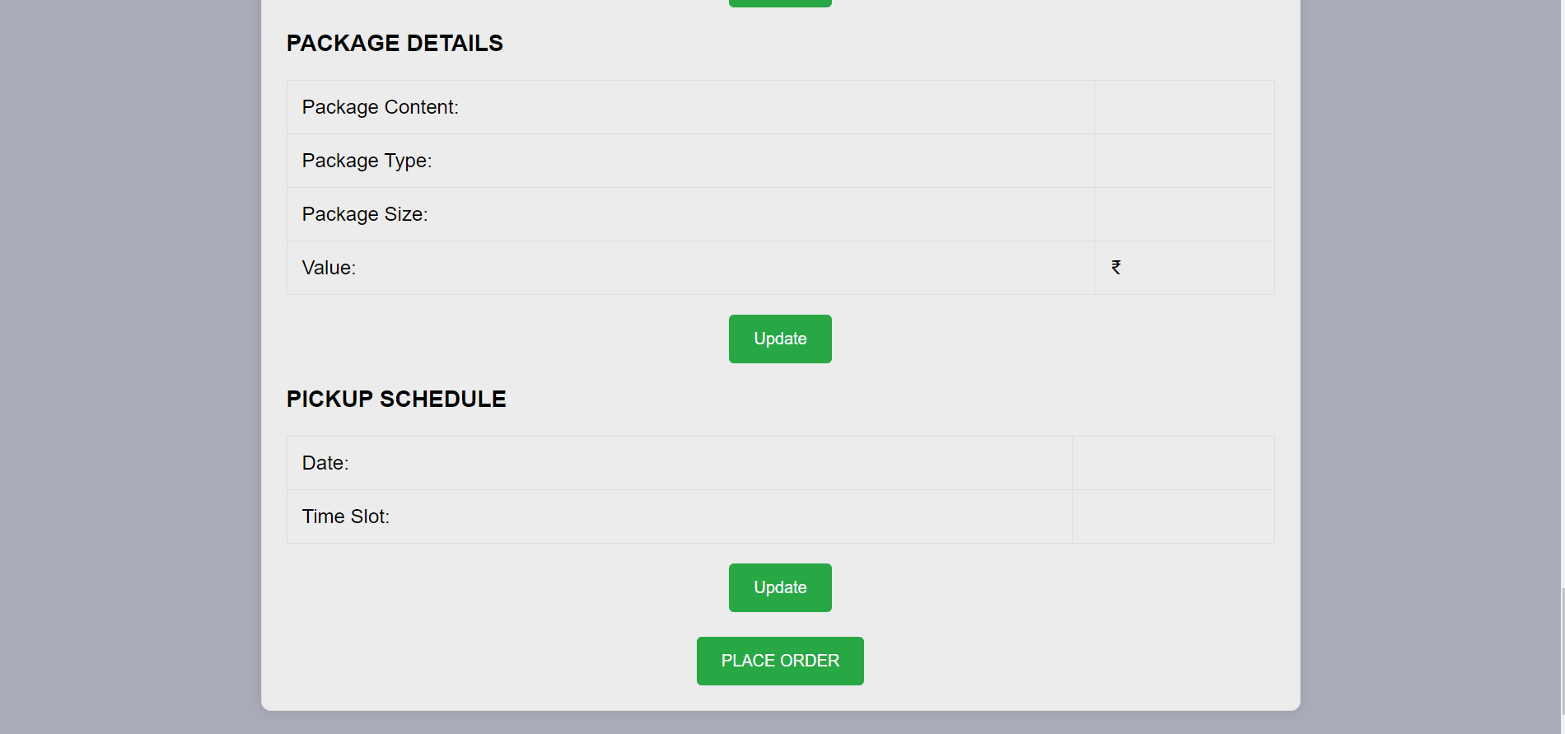
Code snippets or screenshots if applicable

Slide 10
Features
Real-time parcel tracking for customers
Intelligent route optimization for delivery vehicles
User-friendly interface for customers and logistics staff
Automated notifications for delivery updates
Analytics for performance monitoring and optimization

Slide 11
Results
The project has yielded tangible results in the form of enhanced delivery services through optimization and the successful implementation of an advanced tracking system.
Through the completion of this project, we have gained valuable hands-on experience in the dynamic fields of computer science and engineering. This acquired expertise will undoubtedly prove advantageous as we navigate and contribute to the challenges and innovations within this sector

Slide 12
Challenges Faced
User Experience Design:
Solution: We gathered feedback from our friends in the hostel to refine the interface. Engaged in collaborative design sessions to align aesthetics with functionality.
Integration Complexity:
Solution: Implemented a phased approach, breaking down the integration into smaller, manageable tasks. Conducted thorough testing at each stage to identify and address issues promptly. Collaborated closely with the development team to streamline the integration process.

Slide 13
Future Work
Enhanced Tracking Capabilities:
Improvement: Implement real-time GPS tracking for more precise parcel location updates. Integrate geofencing for customizable delivery zones, providing customers with accurate arrival estimations.
Mobile Application Development:
Extension: Develop a mobile application for both Android and iOS platforms, offering a more convenient and accessible way for users to track shipments, request services, and provide feedback.
Integration with E-commerce Platforms:
Improvement: Explore integration possibilities with major e-commerce platforms to streamline the parcel shipping process. Provide seamless APIs for businesses to directly integrate Kabootar Parcel Services into their online stores.

Slide 14
Conclusion
Key Points:
Successfully implemented an optimized delivery service and an advanced tracking system.
Overcame challenges in integration complexity, user experience design, and data security.
Gained valuable experience in the fields of computer science and engineering.
Significance of the Project:
The project marks a significant achievement in improving the efficiency and reliability of delivery services through optimization and advanced tracking.
The experience gained is crucial for future endeavors in the dynamic fields of computer science and engineering, providing a foundation for continued innovation and success.

Slide 15
Acknowledgments
Mentors: Special thanks to any mentors or advisors who provided valuable feedback, suggestions, and support. Their mentorship was instrumental in overcoming challenges and refining the project to meet its objectives.
Peers and Team Members: A heartfelt thank you to my fellow peers and team members who collaborated tirelessly on various aspects of the project. Their dedication, teamwork, and diverse skill sets significantly enriched the project and contributed to its overall success.

Slide 16
Q&A
Open the floor for questions from the audience

